Slide 1
WHAT IS CLIMATE CHANGE?

Slide 2
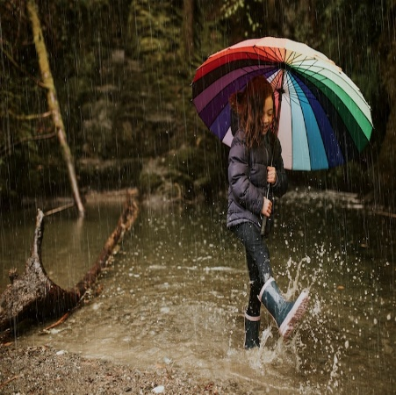
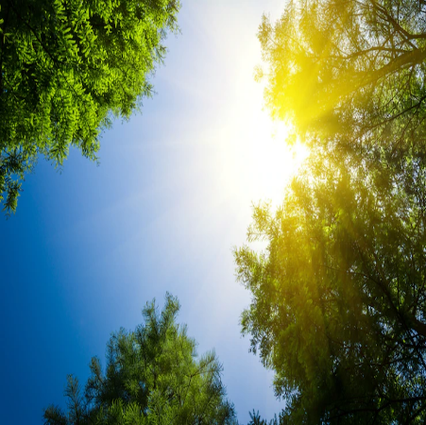
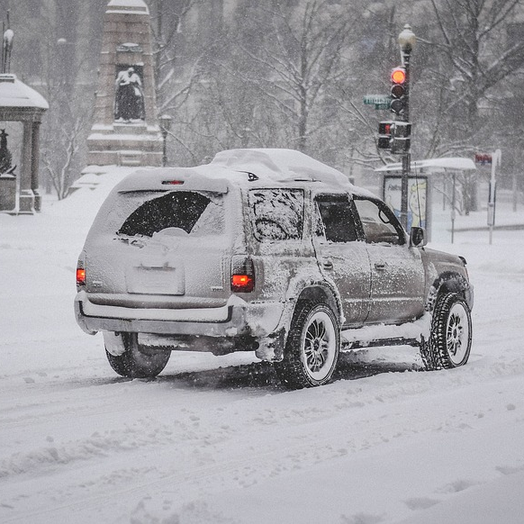
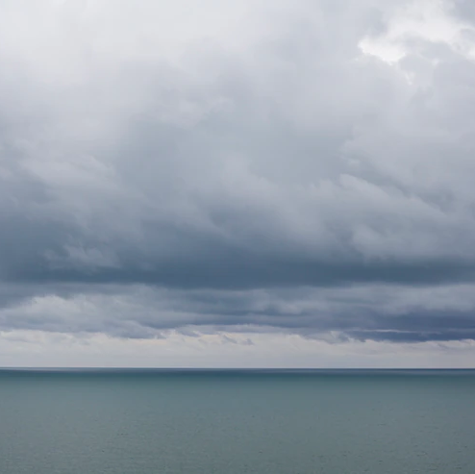
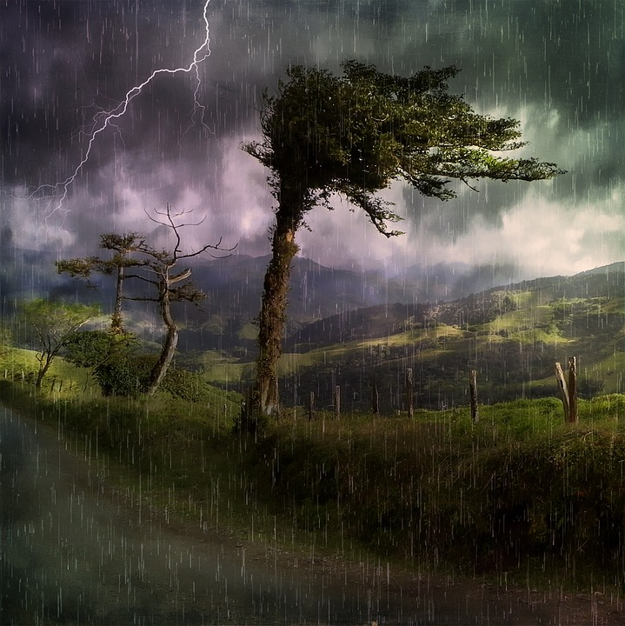
DO YOU KNOW WHAT IS
MEANT BY THE TERM WEATHER?
Let’s take a look!
The weather is what happens in our atmosphere each day.
It is what is happening right now outside.
What is the weather like right now where you are?

Slide 3
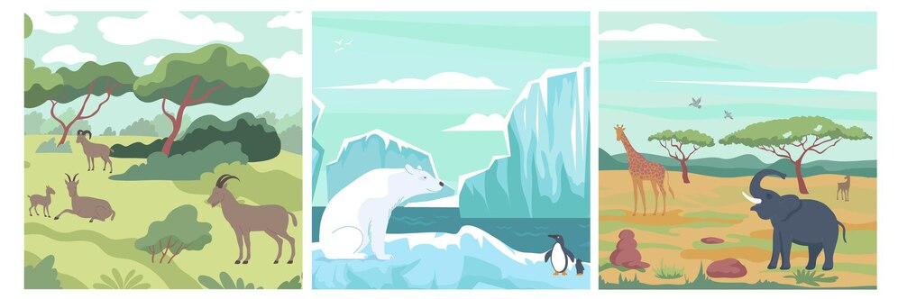
BUT WHAT IS CLIMATE?
The climate is the pattern of weather over a long period of time in a specific place.
The weather in a place can change minute by minute but the climate takes years to change.
What is the climate like in the country where you live in?

Slide 4
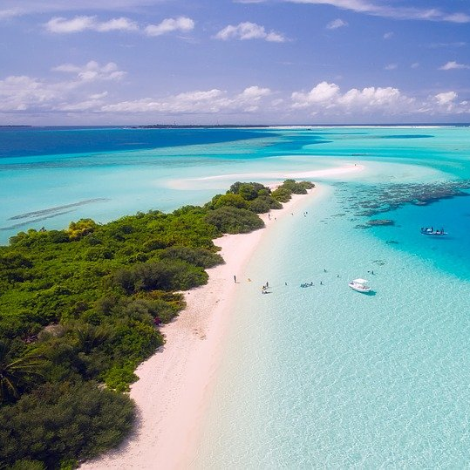
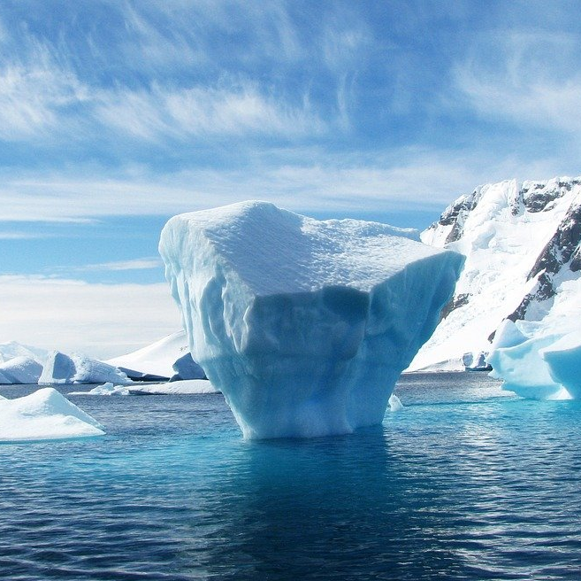
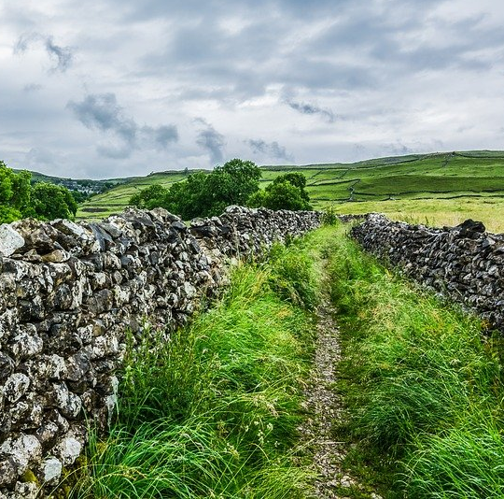
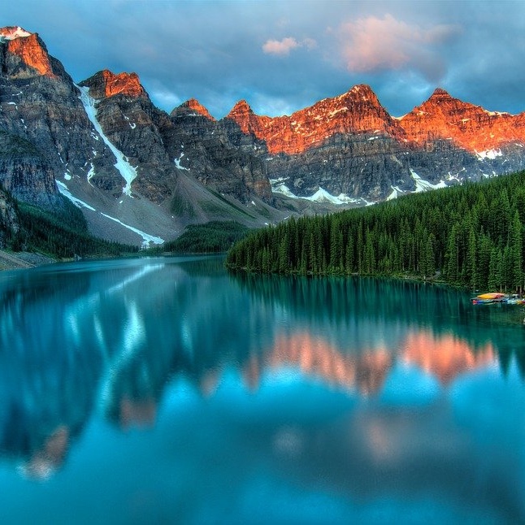
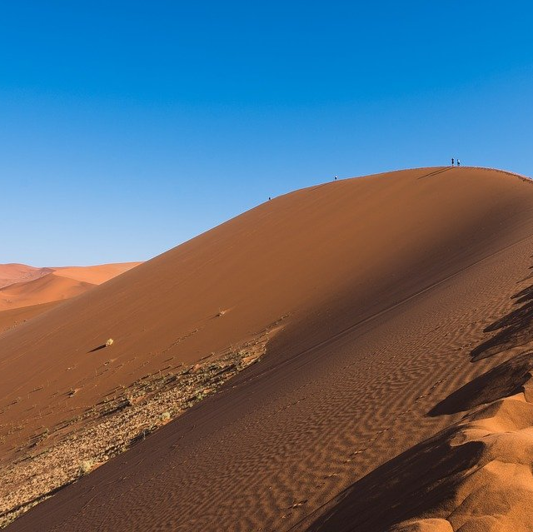
CAN YOU NAME ALL THE
DIFFERENT TYPES OF CLIMATES?
Different countries have different climates depending on
where the country is in relation to the sun and the oceans.

Slide 5
CAN YOU NAME ALL THE
DIFFERENT TYPES OF CLIMATES?
Different countries have different climates depending on
where the country is in relation to the sun and the oceans.
tropical
polar
temperate
continental
dry

Slide 6
WHY IS THE CLIMATE CHANGING?
Watch the video to find out all about climate change.

Slide 7
Climate or Weather Quiz
It’s time to test your knowledge
of climate change!
Do you think each of the statements is about weather or climate?
Remember that weather can change minute
by minute and the climate takes years to change.

Slide 8
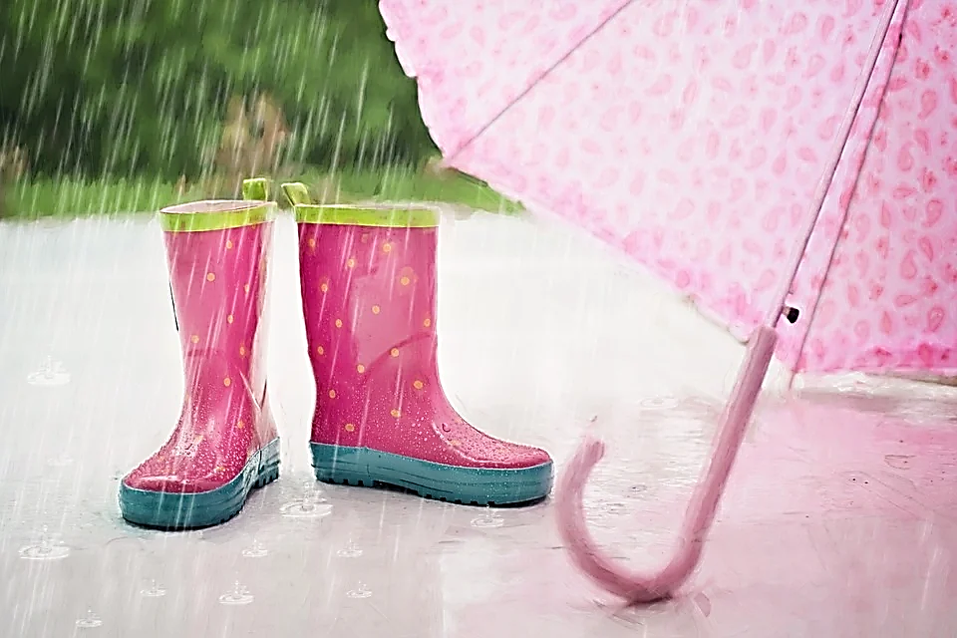
If it is sunny at the weekend, you can go to the park.

Slide 9
If it is sunny at the weekend, you can go to the park.
weather

Slide 10
The rocket launch was cancelled due to high winds.

Slide 11
The rocket launch was cancelled due to high winds.
weather

Slide 12
Most of Canada has warm summers and cold winters.

Slide 13
Most of Canada has warm summers and cold winters.
climate

Slide 14
It is measured over several years.

Slide 15
climate
It is measured over several years.

Slide 16
The Earth is getting hotter.

Slide 17
climate
The Earth is getting hotter.

Slide 18
It measures the temperature and rain fall over several days.

Slide 19
It measures the temperature and rain fall over several days.
weather

Slide 20
It is rising due to the greenhouse gases.

Slide 21
It is rising due to the greenhouse gases.
climate

Slide 22
IMAGE CREDITS
Slide(s) | Photo | Attribution
2 | Rain | By rawpixel.com via freepik
2 | Sunny | By evening_tao via freepik
2 | Cloudy | By freestockcenter via freepik
2 | Storm | By pezibear via Pixabay
2 | Snow | By janeb13 via Pixabay
3 | Climates | By macrovector via freepik
4/5 | Tropical | By 12019 via Pixabay
4/5 | Desert | By jbauer-fotographie via Pixabay
4/5 | Countryside | By TimHill via Pixabay
4/5 | Canada | By JamesWheeler via Pixabay
4/5 | Polar | By 358611 via Pixabay
8-21 | Wellingtons | By JillWellington via Pixabay

