Slide 1
THE CLIMATE CRISIS
A resource to help explain the Climate Crisis and why we all need to be more Climate Clever.

Slide 2
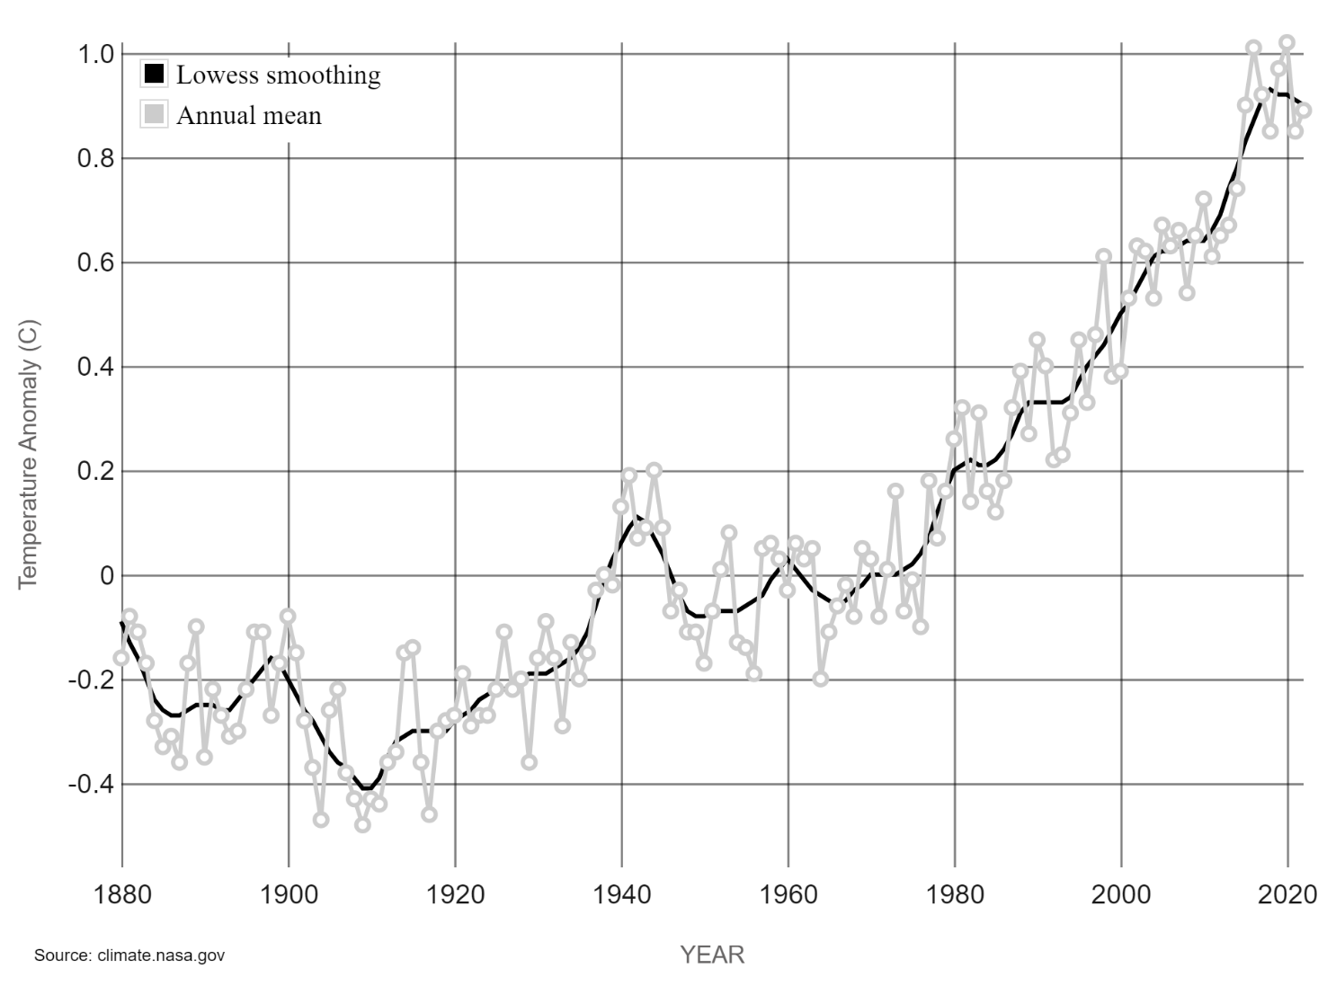
THE AVERAGE GLOBAL
TEMPERATURE IS RISING
The annual global temperature is now about 1.1 degrees Celsius hotter than pre-industrial levels.
Although Earth has always had natural cycles of warming and cooling, it has never seen changes like we’re seeing now.
Records are being broken year on year.
Global Temperature Index NASA

Slide 3
PROGRESSION OF CHANGING GLOBAL SURFACE TERMPERATURE ABNORMALATIES
Higher than normal temperatures are shown in red and lower than normal temperatures are shown in blue.

Slide 4
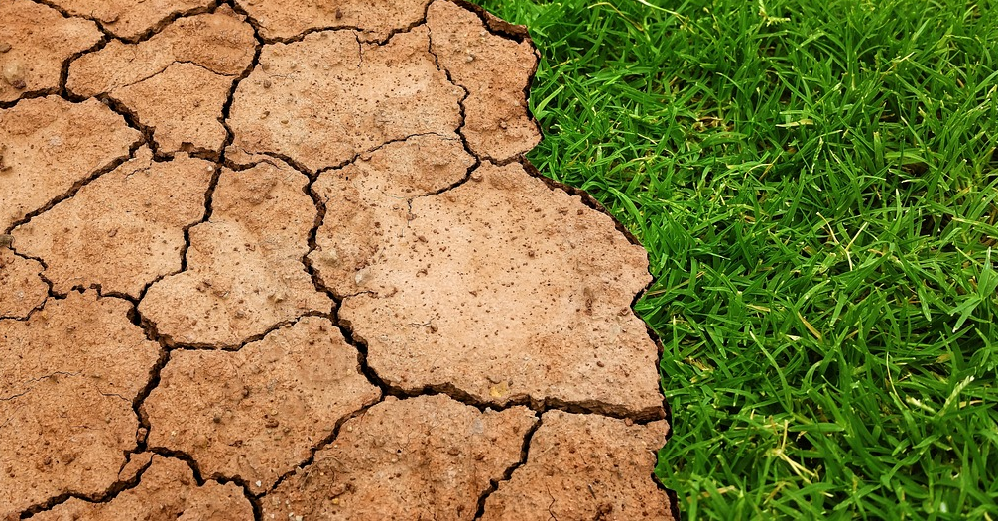
RISING GLOBAL TEMPERATURES
But what does that mean for us?
Even the smallest changes in global temperatures
can mean big changes for our planet.
Studies are now reporting that exceeding 1.5 degrees Celsius could trigger multiple “climate tipping points”
in our climate system. “These changes may lead to abrupt, irreversible, and dangerous impacts with serious implication for humanity.”

Slide 5
WHAT IS CAUSING IT?
Simply put, it’s us.
Click to view daily recordings of ppm
Before the large use of fossil fuels, our atmosphere typically contained approximately 280 parts per million of carbon dioxide. Now the atmosphere is estimated to contain 420 parts per million.
The increase in global temperatures closely correlates with the release of greenhouse gases, the increase use of fossil fuels and demand for animal-based agriculture.

Slide 6
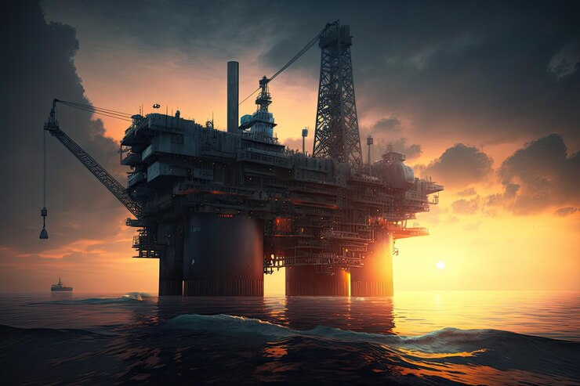
FOSSIL FUELS
Despite the rise in global temperatures, and the signs of the climate crisis, large corporations continue to mine and burn fossil fuels.
Major oil companies, including BP and Shell, have spent hundreds of millions of pounds trying to delay and even stop government policies that would have helped tackle the climate crisis.

Slide 7
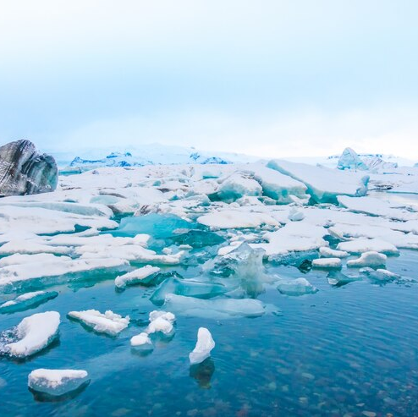
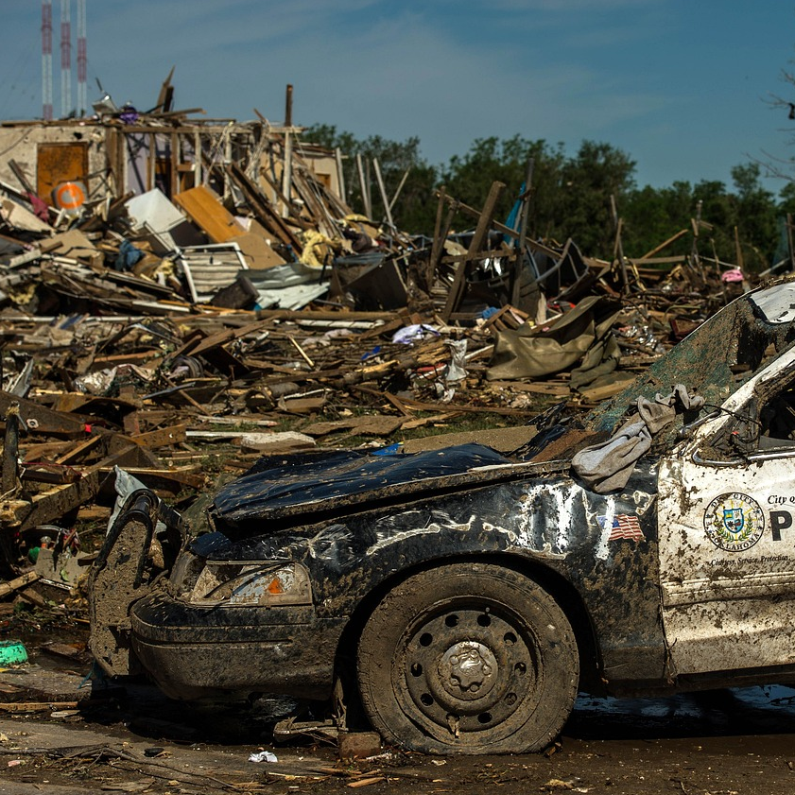
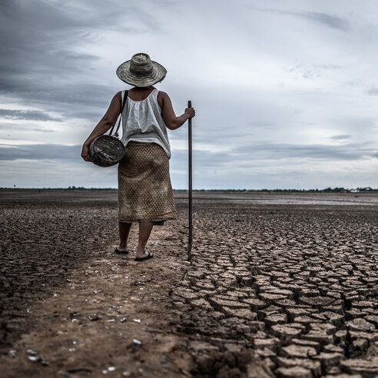
THE EFFECTS OF CLIMATE CHANGE
The changes are everywhere.
Droughts and floods are occurring more frequently due to the shift in rainfall patterns.
Ice sheets are melting in the Arctic and Antarctica, leading to the rise in sea levels.
Storms are increasing in strength and frequency.

Slide 8
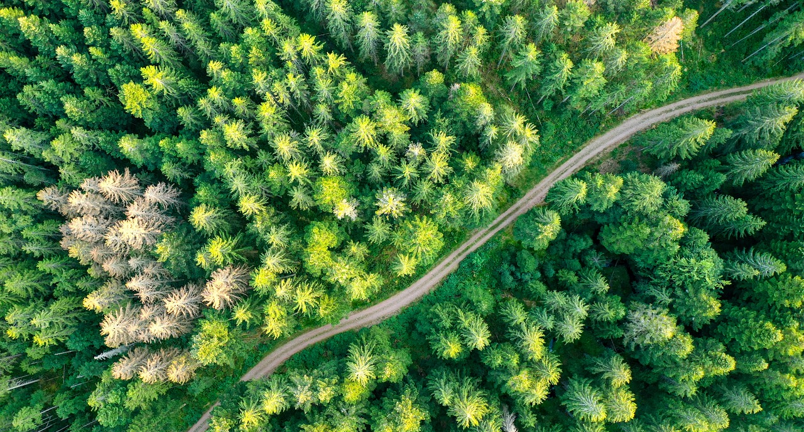
CARBON OFFSETTING
Does it really work?
Companies such as airlines and oil companies love to say that they are offsetting carbon.
In order to be serious about tackling climate change, companies need to stop the carbon emission from getting in to the atmosphere in the first place.
Greenpeace article - The biggest problem with carbon offsetting is that it doesn’t really work

Slide 9
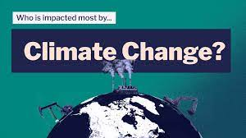
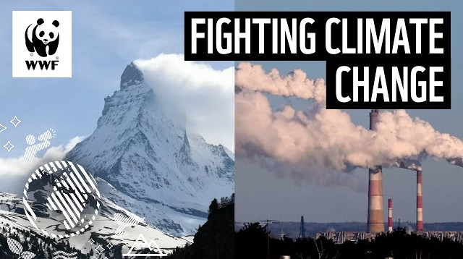
MORE INFORMATION
Take a look at the videos below to find out more.
Click on each image to watch the videos.
Greenpeace - Climate solutions are here! Let’s go!
Friends of the Earth - Who does climate change affect most?
WWF - Fighting climate change to save our one shared home.

Slide 10
IMAGE CREDITS
Slide(s) | Photo | Attribution
4 | Grass and drought | By Tumisui via Pixabay
6 | Oil rig | By chandlervid85 via Freepik
7 | Sea ice | By jannoon028 via Freepik
7 | Storm damage | By chandlervid85 via Freepik
7 | Drought | By 12019 via Pixabay
8 | Forest | By pyrech via Freepik

